Slide 1
Welcome to Curriculum Night
Mrs. Kyle
Fourth Grade
Room 17

Slide 2

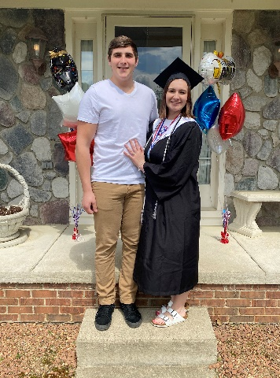
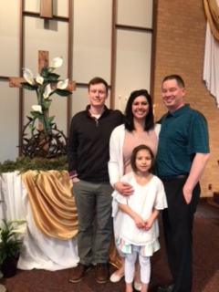
Introduction
My name is Pam Kyle.
This is my 26th year of teaching at Webber and my 38th year of teaching in all.
I have three daughters and two granddaughters.
I enjoy reading, scrapbooking, and spending time with family and friends.

Slide 3
Contact Information
Please contact me with any questions, comments, or concerns at:
pamela.kyle@lok12.org
School- (248) 391-0400 ext. 2017
SeeSaw

Slide 4

Remind101
101
Remind is a communication platform that will let you receive messages from me. To sign up you need to:
Text: @c2ge7f
To: 81010
You will receive a message stating, “You have joined Mrs. Kyle” It will give you a link to get the app.

Slide 5
4th Grade = CHANGE
Creating and teaching responsibility, organization, and independence are our goals
Greater expectations as the year progresses in order to foster increased maturity and active learning skills
Teaching students how to study and plan ahead for long term assignments
        Note taking, using a variety of study guides, using resources

Slide 6
4th Grade = CHANGE
Michigan State Standards
Spending more time on a concept to develop a deeper understanding
Nonfiction and fiction are given equal attention and academic vocabulary is emphasized
Looking for growth in reading, writing, and speaking skills
Text-based evidence is needed to back up claims

Slide 7


Report Cards
Report Card – Standards Based Grading
  4- Met standard
  3- consistent progress towards standard
  2- inconsistent progress towards standard
  1- area of concern
  Semester report cards (February and June)
  20 min. Fall Conference - Nov. 9 & 11
  20 min. Spring Conference – March 17 & 22
  Sign-up Genius links will be provided.

Slide 8
4th Grade Curriculum
Language Arts
Reading- Reader’s Workshop
  Focus on Reading to Learn
  Poetry, Historical Fiction, Realistic Fiction, Expository Nonfiction, Narrative Nonfiction, and Biographies
  Assessment
    Projects
      Literature Evaluations (typed in class)
        Non-fiction and Fiction
      Shares (in class)
      Post-It Note Quizzes
      Scholastic News - nonfiction
  Book Contract

Slide 9
4th Grade Curriculum
Writing- Writer’s Workshop-Students explore themes, character development, author’s craft, audience, and writing for a purpose
  Paragraph Writing
  Poetry
  Narrative Writing
  Informational Writing
  Opinion Writing
Word Study
  Word Patterns, vocabulary, syllables, prefixes, suffixes, homophones, grammar in read a louds.

Slide 10
4th Grade Curriculum
Math
Math Expressions
Place Value, Addition, Subtraction, Multiplication, Division, Multi-Step Word Problems, Fractions, Decimals, Measurement and Geometry
Students need to know ALL math facts FLUENTLY!

Slide 11
4th Grade Curriculum
Science
Science – Phenomenal Science:
A blend of scientific knowledge and engineering practices and concepts.
Students will ask questions, investigate concepts, and participate in scientific argumentation.
Unit 1 – Let It Rip – Energy
Unit 2 – Surf’s Up – Waves
Unit 3 – Big Blue Marble – processes that shape the Earth
5 E’s = engage, explore, explain, elaborate, and evaluate

Slide 12
4th Grade Curriculum
Social Studies
  Economics
  History
  Civics and Government
  Geography of the United States
Technology
    Keyboarding Skills
    Microsoft Office 365 – one drive, email, PowerPoint
    SeeSaw
    Powerschool – Student login & Parent Login

Slide 13

Positivity Project
“The Positivity Project is a non-profit organization dedicated to helping America’s youth build stronger relationships by recognizing the character strengths in themselves and others. Their vision is to create citizens and leaders who will enhance our communities and country by internalizing the belief that “Other People Matter.”
~Positivity Project Family Information Letter
The students will be learning about 24 character traits this school year. Each trait will be focused on for one to two weeks to help students understand them through definition, examples, discussions, and exercises. More information about this project can be found on the website: www.posproject.org

Slide 14
Classroom Expectations
    Have self control
    Be responsible
    Make good choices
    Be respectful
    Create good study habits
    100 % effort at all times

Slide 15


Buck-A- Roo
Classroom economy that teaches economic standards
Students are paid, in Webber Bucks, $5.00 a day and charged $1.00 a day for rent.
Students get fines for rules not followed but receive bonuses for going above and beyond.
They save their money to pay for individual or classroom incentives.
They are responsible for keeping track of their money.
An information sheet will be sent to you via email.

Slide 16



Parent Expectations
Provide your child with their own workspace at home
Read the weekly newsletters
Sign the planner
Take out the papers from the Take Home pocket daily, leave all other papers in the pockets.

Slide 17

Book Orders
* You can order online at scholastic.com/readingclub
Our One-Time Class Activation Code: L4HX9
If you choose to order, I will let you know a date to pick up your books.

Slide 18

Closing
Thank you very much for attending our curriculum night tonight. At this time I am going to end our meeting. If you have any questions regarding our schedule, procedures, or curriculum, please feel free to send me an email at: pamela.kyle@lok12.org. If there are any questions regarding technology issues, please feel free to contact tech services via email at tech.services@lok12.org.

